Slide 1
Principles of Pharmacology & Toxicology
Week 1

Slide 2
Toxicology Defined
Study of adverse effects of chemical or physical agents on living organisms
Casarett & Doull's Toxicology
The study of the adverse effects of chemical, physical, or biological agents on people, animals, and the environment
Society of Toxicology (web page)
The study of poisonous chemicals, drugs, etc., and how a person or other living thing reacts to them
Merriam-Webster online

Slide 3
Terminology
Toxic Agents
any substance producing toxicity
Toxins
toxic agent produced by biological systems
plant, animal, bacteria, fungi
Toxicants
toxic agents produced by or by-product of human activity
Exposure
physical contact or dosing with a toxic agent

Slide 4
Toxicologic
Chemical Allergy
immunologically mediated reaction to a chemical
may involve sensitization (pre-exposure)
hypersensitivity reaction observed thereafter
chemicals not sufficiently immunogenic, so combines with protein as hapten to be immunogenic
Chemical Idiosyncracy
abnormal reaction to chemical
genetically based
long duration of succinylcholine metabolism because of slow-metabolizing pseudocholinesterase phenotype
NADH-cytochrome b5 reductase deficiency: susceptibility to nitrites, leading to methemoglobin formation, low oxygen carrying capability

Slide 5
Toxicologic
Immediate vs Delayed Toxicity
Some toxic effects may not be seen for years, such as carcinogens causing disease decades later
Vaginal cancers in young adult females whose mothers used diethylstibestrol (DES) with in utero exposure (20-30 y later)
Organophosphorus insecticides (e.g. triorthocresylphoshate [TOCP]) causing degeneration of long axons in PNS & CNS over several days

Slide 6
Overlap with Pharmacology
Principles of toxicology overlaps a great deal with the fundamentals of pharmacology
Drugs both natural and synthetic can be given at one dose to achieve a desired or intended therapeutic effect, but at a higher dose can produce a toxic effect
Thus, concepts in pharmacology are presented in concert with instruction in toxicology

Slide 7
Good Things & Bad Things
A Philosophical Consideration
Bad Things Always Bad Things (Or Are They?)
Snake venom always thought bad
But many venoms or their refined molecular products used for medical therapy
Thus: Good Things Sometimes Bad Things
A lesson?
Be prepared to evaluate the "incontrovertible facts" from time to time

Slide 8
Toxicant Chemistry
Lipophilic / Hydrophobic / Fat-Soluble
alkyl (methylene: –CH₂–)
Hydrophilic / Water-Soluble
Polar Nonionic: hydroxyl –OH groups
Ionic (pH-dependent and –independent)
Cationic (+ charged): amine –NH₂ groups
Anionic (– charged): carboxyl –COOH groups

Slide 9
Toxicant Permeability
Fully lipophilic toxicants can easily cross cell membrane phospholipid bilayers
Toxicants with any ionized (positively or negatively electrically charged) functional groups cannot freely cross the lipid bilayer
This includes zwitterionic toxicants that may have a net charge of zero on the molecule
An absence of charged groups does not guarantee membrane permeability, since functional groups may have significant hydrophilic polar groups

Slide 10
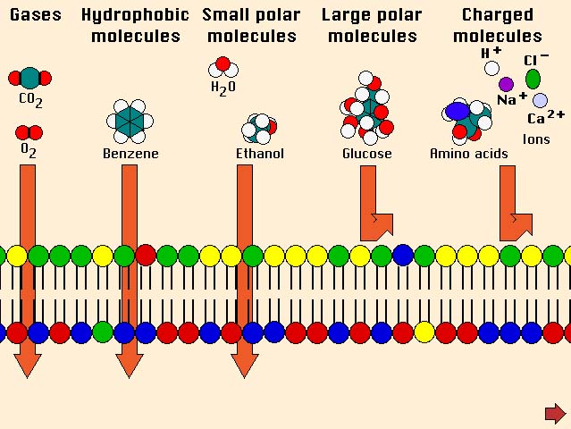
Chemistry of Membrane Permeability
Molecules having no net polarity ("dipole"), especially hydrophobic or lipophilic, cross the lipophilic lipid bilayer of cell membranes without difficulty
Molecules having a net polarity or having many polar groups or having electric charges (ions) do not cross the membrane
Impermeable molecules must have special channel or transport proteins in membrane to open gate for them to cross

Slide 11
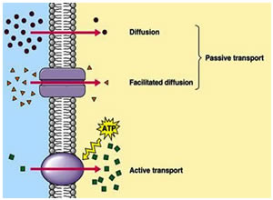
Getting Across A Membrane
Thermodynamic laws explain that molecules will diffuse within a space (volume) to distribute themselves evenly within that space: it's same for the volume of the body
Cell membranes represent a barrier to this diffusion for most, not all molecules
For those that can cross membranes, the simple diffusion process works
For others, proteins move with their concentration gradient through channels in membrane proteins
http://pharmafactz.com/wp/wp-content/uploads/2014/12/active-transport.jpg

Slide 12
Getting Across A Membrane
Active transport uses the cell's energy (ATP) to move molecules against their concentration gradient
The figure shows an ATP-dependent transport membrane protein moving molecules into a cell, but there are many ATP-dependent transporters that use energy to move molecules out of cells (e.g., the drug efflux transporters mentioned in this course)
http://pharmafactz.com/wp/wp-content/uploads/2014/12/active-transport.jpg

Slide 13
Permeability & pH-Dependence
Toxicant
Class
red boxed toxicants not guaranteed permeability, but have stronger potential
zwitterions
HOOC
N⁺H₃
–OOC
N⁺H₃
–OOC
NH₂
acidic
COOH
COO–
COO–
basic
N⁺H₃
N⁺H₃
NH₂
low pH
neutral pH
high pH

Slide 14
Dose-Response
Dose: administer substance (drug, poison) in specific quantity
Response: observe a variety of effects, whether intended/expected or unintended/unexpected
The "therapeutic" effect: a desired effect from a drug (not an effect for toxicology)
The "side" effect: the willingness to tolerate unpleasant, uncomfortable, and sometimes painful effects in order to obtain the therapeutic effect
The "toxic" effect: the intolerable circumstance where health or life is endangered; generally an acute effect; chronic effects less perceptible

Slide 15
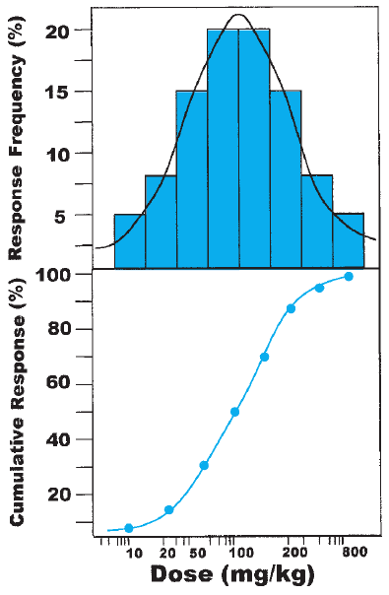
Responses in Populations
The dose at which individuals in a population show a response (effect) to a drug or toxicant is normally distributed generally
top panel in figure
The plot of the cumulative percentage showing the response to the dose has value in determining the dosage for drug
This is the Dose-Response curve/plot
bottom panel in figure

Slide 16
The Dose-Response Curve
Dose-Response relationships are plotted as the cumulative percentage of a population showing an effect as a particular dose
They are used for setting the appropriate dose of a drug
The ED₅₀ parameter refers to the "effective dose" for 50% of the population
That is, the ED₅₀ is the dose at which the desired effect is produced in 50% of the population

Slide 17
Toxic Doses / Lethal Doses
The Dose-Response curves apply for all manner of responses:
toxic response
toxic response 1 (TR1): suppose loss of vision
toxic response 2 (TR2): suppose hemiplegia
the dose producing toxicity in 50% of the population: TD₅₀
lethal response
the ultimate toxic response
the dose producing death in 50% of the individual in the population is the LD₅₀

Slide 18
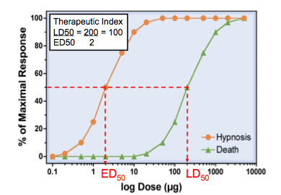
Therapeutic Index
In pharmacology, this value is a measure of how safe a (therapeutic) drug is with respect to obtaining the intended effect and risking seeing a toxic effect, especially the lethal effect
This is the ratio TD₅₀ / ED₅₀
Agonist | TI
THC (cannabis) | 1000
diazepam | 100
morphine | 70
digoxin | 2

Slide 19
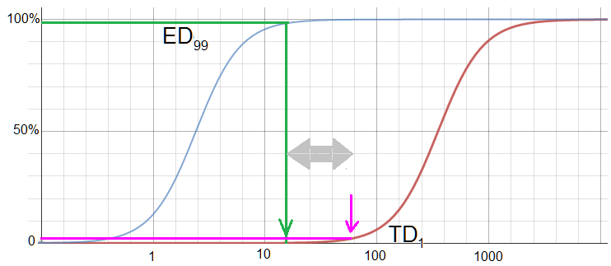
Margin of Safety: TD₁ ÷ ED₉₉
Another parameter of the dose-response curve is the margin of safety, the ratio of TD₁ ÷ ED₉₉
If the TD₁ is really the LD₁, then this would be of more value than a therapeutic index, in the even that the ED curve near 100% could even overlap the LD curve at close to 0%

Slide 20
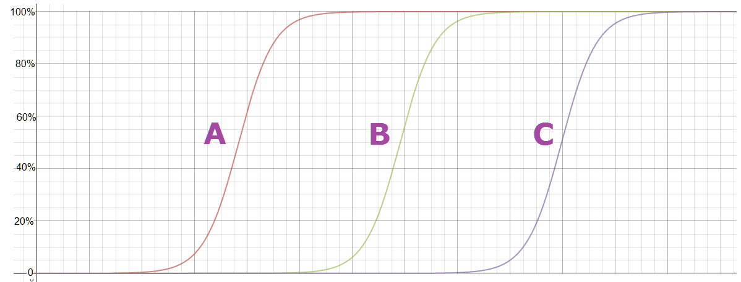
Potency
Potency reflects the amount of drug/toxicant necessary to produce the effect
It is a comparative tool for drugs/toxicants producing the same effect
Suppose A, B, C are toxicants causing tumors in test animals: as the curve shows, A produces the effect at lower doses than B or C, and so it is more potent than either B or C

Slide 21
Toxicokinetics / Pharmacokinetics
The study of how a drug enters the body, is changed by the body, and is eliminated by the body
Four processes describe toxico/pharmacokinetics:
Absorption
The process where a toxicant passes barriers (GI tract, skin, lung aveoli) to get into the systemic circulation
Distribution
The process where the toxicant increases its concentration in vascular, interstitial and intracellular volume

Slide 22
Toxicokinetics / Pharmacokinetics (cont)
Metabolism (Biotransformation)
The process where the cell reduces the level/concentration of toxicant (de-toxifies) by chemically modifying it
Elimination
The process in which the body attempts to excrete the toxicant or a modified form of it (its detoxified products)

Slide 23
Absorption
This is about getting a toxicant/drug past the barriers to the systemic circulation
Ingestion / Oral
Most any toxicant in a pill/tablet/liquid
Inhalation
Gaseous/vapor toxicants
Dermal
lipophilic toxicants particularly
Rectal
suppositories
does not include intravenous (i.v.) administration, since that is a direct route past the barriers

Slide 24
Chemistry of Absorption
The unionized (electrically uncharged) toxicant more readily passes a cell membrane barrier than an ionized toxicant
Absorption of pH-dependent toxicants affected by pH
[note: this information is a repeat of previous slides]

Slide 25
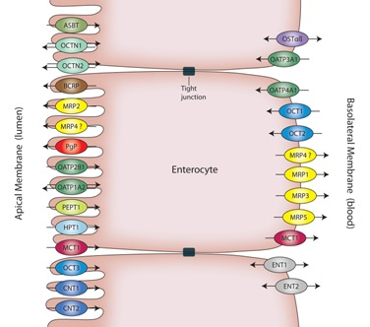
GI Tract
The intestines represent an initial barrier to absorption
Intestinal epithelial cells (enterocytes) form "tight junctions" as a barrier to simple diffusion of toxicants into blood
Additionally they have membrane proteins actively transporting xenobiotics back into intestinal lumen left side of cell in figure
while you don't need to memorize names of the efflux or exchange transporter proteins in the figure, you will likely encounter their mention
in the research you do for your presentations
http://www.solvobiotech.com/images/uploads/Enterocytes1.jpg

Slide 26
MDR Efflux Transporters
Certain membrane proteins (P-glycoprotein) use ATP to drive out cytotoxic xenobiotics, some of which are cancer drugs
These transporters pump out multiple drugs (multi-drug resistance [MDR]) with broad specificity and are present in a large variety of cell types
High expression of these proteins is likely in cells whose organs function as the first guard in exposure to toxicants
intestinal epithelium
liver hepatocytes

Slide 27
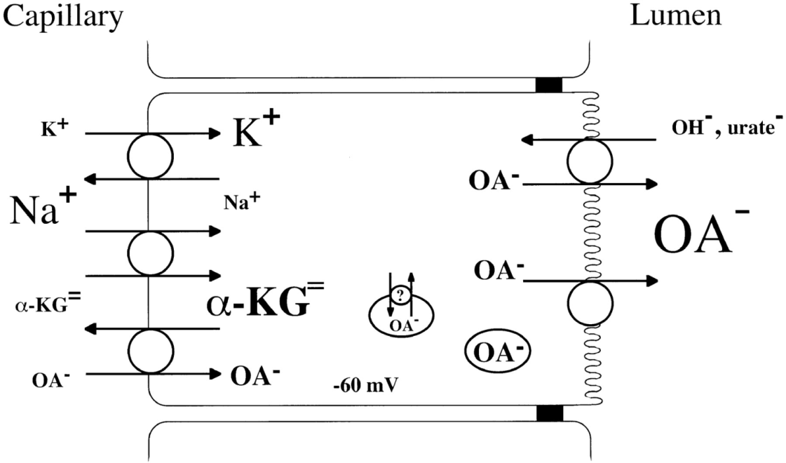
Coupled Ionic Transporters
This type of membrane protein transporters are also involved in the efflux of toxicants to prevent absorption into systemic circulation
Negatively charged toxicants (organic anions) are transported to the lumenal (excretory) side of epithelial cells in kidney and intestine
http://ajprenal.physiology.org/content/281/2/F197

Slide 28
Distribution
Distribution is the process of a drug/toxicant circulating the vascular volume and reaching the tissues, intracellular and interstitium
Factors affecting distribution include
blood flow: flow to organs (liver, kidney, brain) is greater than to other parts of body
capillary permeability
binding affinity of drugs/toxicants to plasma or tissue proteins

Slide 29
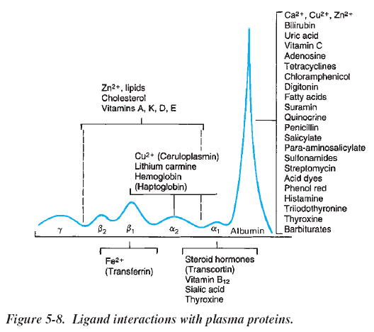
Plasma Protein Binding
Proteins in plasma will bind to many drugs, affecting and limiting their distribution outside vascular volume
Ligand-binding preferences
α & β lipoproteins
many lipophilic substances
α₁-acid glycoprotein
basic substances
metal-binding proteins
drugs/toxicants with metal cations

Slide 30
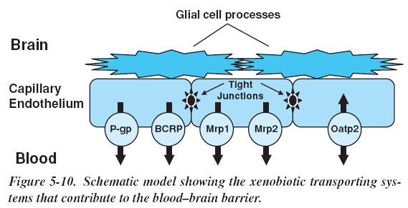
Blood-Brain Barrier
Distribution to CNS tissue & fluid space limited by blood-brain barrier
Endothelial cells in brain capillaries forming tight junctions to inhibit polar substances entering CNS
Xenobiotic efflux transporters in cells actively keep lipophilic substance out
Pgp + BCRP (cations+neutral) Mrp2 + Mrp4 (anions + neutral)
Glial cells (astrocytes + microglia) extend processes on endothelium to act as (reinforce) barrier

Slide 31
Blood-CSF Barrier
Epithelial cells of choroid plexus on other side of capillary epithelium form part of barrier. Cells have xenobiotic efflux transporters (as do endothelial cells)
Luminal P-gp and basolateral Mrp1
Oatp3, Oat3, Oct, and Pept2 also involved
("Oat"=organic anion transporter, "Oct"=org cation transporter)
The low protein content of CSF also prevents toxicity of xenobiotics that are protein binders

Slide 32
Facts about CNS Barriers
BBB not as well developed in newborns compared to adults so xenobiotics/drugs might enter brain
Some areas of the brain more accessible: cortex, hypothalamus lateral nuclei, neurohypophysis
bilirubin and morphine more toxic
due to increased blood supply to the these parts or is barrier more permeable?

Slide 33
Crossing The Placenta
Humans have a hemochorial placenta: the fetal placental tissues are cellular but the maternal cellularity is gone
Most nutrients move from maternal blood to fetal circulation by active transport

Slide 34

Volume of Distribution (V_{d})
Distribution is the process of a drug/toxicant leaving the circulation and reaching the tissues (intracellular and interstices)
Factors affecting distribution include
blood flow: flow to organs (liver, kidney, brain) is greater than to other parts of body
capillary permeability
binding affinity of drugs/toxicants to plasma or tissue proteins
$$V_{d}=\frac{Dose}{C_{0}}$$
where C₀ is the plasma concentration at "time zero"
If possible, administer dose intravenously, then sample blood several times quickly after administration to approximate C₀

Slide 35
Bioavailability
Bioavailability is the fraction of drug/toxicant reaching systemic circulation compared to dose given
F = computed amount in circulation / dose
If 80 mg of a 100 mg dose reach circulation, then F = 0.80
This is important for determining doses of drugs/toxicants that enter circulation by non-intravenous routes
It is assumed that a drug/toxicant given intravenously has F = 1.0
Bioequivalence: If two drugs/toxicants show similar bioavailability and pharmacokinetics, they are bioequivalent

Slide 36
Bioavailability Factors
If toxicant/drug injected intravenously, F = 1.0 (bioavailability = 100%)
Oral administration of drug imposes factors:
First-pass hepatic metabolism
All drugs & toxicants absorbed in gut enter the portal vein to the liver, so are exposed to liver enzymes expressly designed to filter out and detoxify xenobiotics
Drug solubility
molecules should not be very lipophilic (insoluble in aqueous compartments) nor very hydrophilic (cannot easily cross membrane barriers
Best are those that are weak acids and bases

Slide 37
Bioavailability Factors (continued)
Chemical stability
For pharmacologically significant drugs, the molecular nature cannot be altered if it is to remain effective
Drug formulation characteristics
size of particles/grain: smaller size generally improves absorpition
salt vs free acid/free base form: site of absorption (stomach vs intestine)
enteric coating: site of absorption
binders, dispersing agents: affect dissolution

Slide 38
Detoxification
All cells of the body have the ability to chemically modify the molecules, including toxicants, that enter them
Most modifications are enzymatic, but non-enzymatic reactions can occur
Cells that form a lining that is a barrier between where toxicants can pass to a compartment will have mechanisms to detoxify or thwart passage
capillary endothelium, GI tract epithelium
The liver is the gate to the systemic circulation of substances that manage to get past the epithelial cells of the GI tract. It is a major organ of detoxification

Slide 39
Biotransformation
The response of the body (cells) to alter the toxicity of xenobiotics
Used for useful drugs and toxicants alike
Occurs in two phases (Phase I and Phase II)
Biotransformation involves biochemical reactions to chemically alter toxicants so that they become excretable
They also provide the possible additional benefits of detoxifying the toxicant and preventing its ability to easily cross membranes of cells and thus distribute itself throughout the body
All biotransformations are mediated by enzymes with but few exceptions where reactions are spontaneous

Slide 40
Phase I Biotransformation
Phase I involves chemical reactions that can radically alter the molecular structure of the toxicant
The intention is to add functional groups that "put a handle" on the molecule so it can excreted
The transformation also make the molecule polar or ionized, preventing the molecule from easily crossing cell membranes
Additionally the toxic nature can be neutralized
However in some cases, the resulting metabolite might be even more toxic

Slide 41
Phase I Reactions
Fall into three basic classes
Oxidation
Many of these reactions are catalyzed by the cytochrome P450 enzymes
Reduction
Many oxidoreductases and mono-oxygenases that depend on the co-enzymes NAD, NADP, FAD, and FMN are involved here
Hydrolysis
Enzymes that perform these reactions include carboxylesterases, peptidases, phosphatases, and other hydrolases

Slide 42
Phase II Biotransformation
In this phase, the toxicant undergoes conjugation
Conjugation is the "tagging" or "putting a handle" on the toxicant
The toxicant does not have to have undergone Phase I biotransformation: it may be in a state that allows it anyway

Slide 43
Hydrolysis
The H₂O molecule is introduced into a bond-breaking reaction
This includes trans-esterifying enzymes, where an alcohol (ROH) and not an HOH molecule used
(Carboxyl)esterases
60 kDa glycoproteins found in serum, lysosomes, cytosol and particularly high concentrations in liver ER
5 types in liver, 30 types in brain
These hydrolyze esters RC(=O)-OR' + H₂O → RCOOH + HOR'
Includes acetylcholinesterase & butyrylcholinesterase
Paraoxonases (Lactonases)
hydrolyze organophosphates, cyclic carbonates, lactones, aromatic carboxylic acid esters

Slide 44
Hydrolysis
Epoxide hydrolases
Cytochrome P450 enzymes (discussed later) can form epoxides, which should be hydrolyzed so conjugation (also discussed later) can occur
Peptidases
These enzymes can hydrolyze amino acids from either end of the polypeptide (aminopeptidases and carboxypeptidases) or within the strand (serine and cysteine proteases)

Slide 45
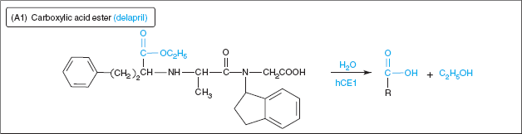
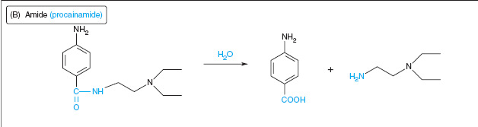
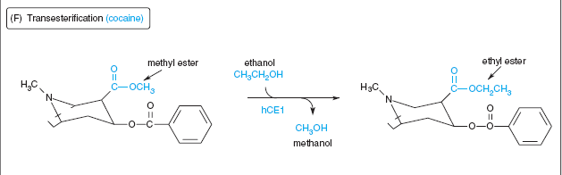
Specific Hydrolytic Reactions
Note H₂O molecule shown in reactions
hCE1 is name of hydrolytic enzyme
Here's a trans-esterification (ROH not HOH)

Slide 46
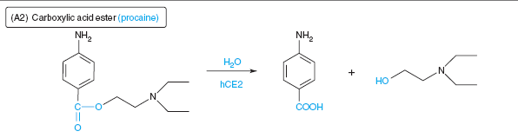
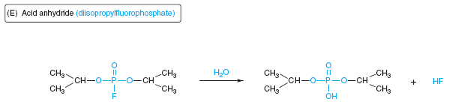
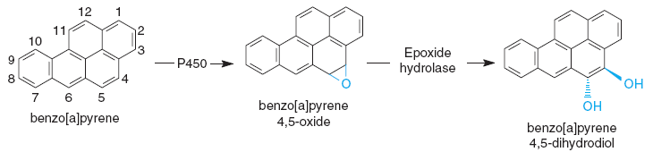
Specific Hydrolytic Reactions
procaine is local anesthetic
The organophosphate DIFP is a powerful anti-cholinesterase that was studied as a nerve warfare agent
The epoxide hydrolase follows the epoxidation by a CYP enzymes

Slide 47
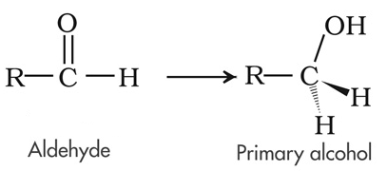
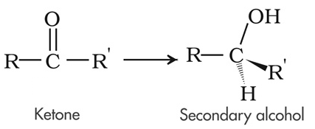
Reductions
When a molecule has electrons transferred to it (often being protonated or acquiring hydrogen atoms too), this is a reduction
These reactions are generally about reducing carbonyl groups in aldehydes & ketones
Reduction transformations can occur in three ways
Enzymatically by host NAD(P)H-dependent oxidoreductases (found in many cells, but chiefly done by liver microsomes)
Nonenzymatically perhaps by direct interaction of an reductant (NAD(P)H, FAD, FMN, glutathione) with toxicant
Intestinal bacteria which have many such enzymes

Slide 48
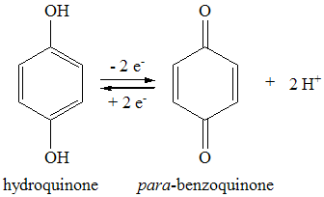
Reduction Enzymes
Many host reductases have been identified, and fall into 4 superfamilies
A table for these reductases is on the next slide
These 4 classes of reductases are
Aldo-keto reductases (AKR)
specific for carbonyl groups (C=O) on aldehydes and ketones
Short-chain dehydrogenase/reductases (SDR)
Medium-chain dehydrogenase/reductases (MDR)
Quinone reductases (NQO)

Slide 49
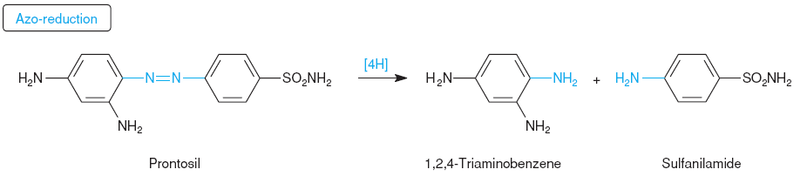
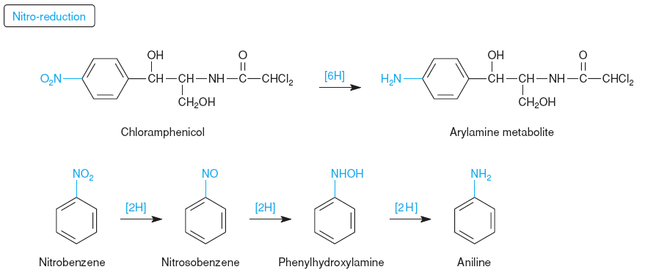
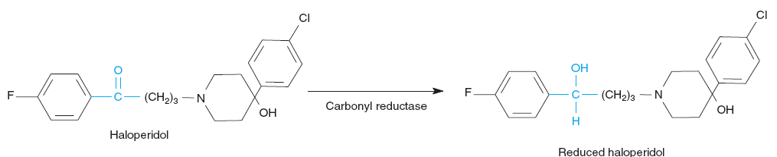
Specific Reduction Reactions
The azo group is R-N=N-R
The double bond was hydrogenated twice to split into amines
Conditions used in the laboratory to reduce aryl (aromatic ring) nitro (–NO₂) groups use toxic chemicals and catalysts
Haloperidol is an anti-psychotic used to treat schizophrenia, choreas, severe anxiety, tics in Tourette's, hiccups not responsive to other care. Used in adults and children

Slide 50
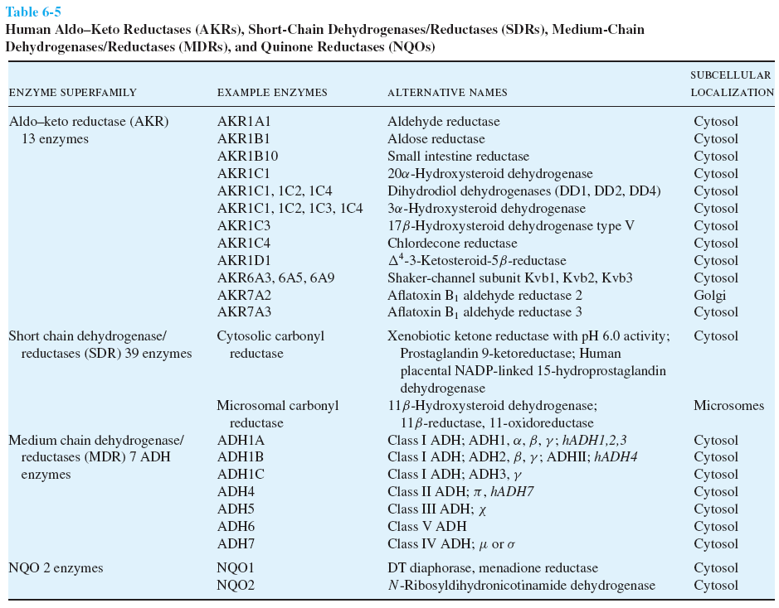

Slide 51
Oxidations
When a molecule has electrons removed from it, this is an oxidation, because much of the time, oxygen (O) atoms are taking the electrons, the O atoms becoming part of the molecule
Dehydrogenations are also oxidations because electrons are taken, although O atoms may not necessarily be bonded products nor involved in the reaction

Slide 52
Oxidation Enzymes
Alcohol, Aldehyde Dehydrogenases
NAD-based enzymes producing aldehydes and carboxylates
Mo²⁺-based Hydroxylases
Aldehyde Oxidase
An Mo²⁺-centered enzyme also
Flavin Mono-oxygenases
creates a reactive hydroperoxide that puts an O atom on the substrate
Cytochrome P450 Enzymes
oxidize a wide variety of substrates

Slide 53
Cytochrome P450 (CYP) Enzymes
These enzymes (at least 57 types) are present in all tissues, but the primary location for detoxifying done in microsomes of liver cells
The catalytic center is a iron-centered heme
In Phase I biotransformations, CYP enzymes perform oxidations
CYP enzymes are mono-oxygenases
Substrate (RH) + O₂ + NADPH + H⁺ → Product (ROH) + H₂O + NADP⁺
The enzymes binds the substrate & O₂ molecule, and gets electrons from another enzyme handling NADPH reductant

Slide 54
Specific CYP Enzymes
Families of CYP enzymes (isoforms) show differences in the variety of substrates bound
CYP3A4/CYP3A5, CYP2D6, CYP2C8/CYP2C9 and CYP1A2 have been identified as carrying out most modifications compared to other CYP isoforms
Intestinal mucosal cell CYP3A4 will metabolize drugs such as chlorpromazine & clonazepam

Slide 55
Induction of CYP Gene Expression
Aside from the chemical reactions & products formed by these oxidizing CYP enzymes, a crucial feature is that the expression of their genes is induced by toxicants
This induction is a sword with many edges
It can render all drugs (other drugs) metabolized by the CYP ineffective or less effective, since their metabolic deactivation is increased.

Slide 56
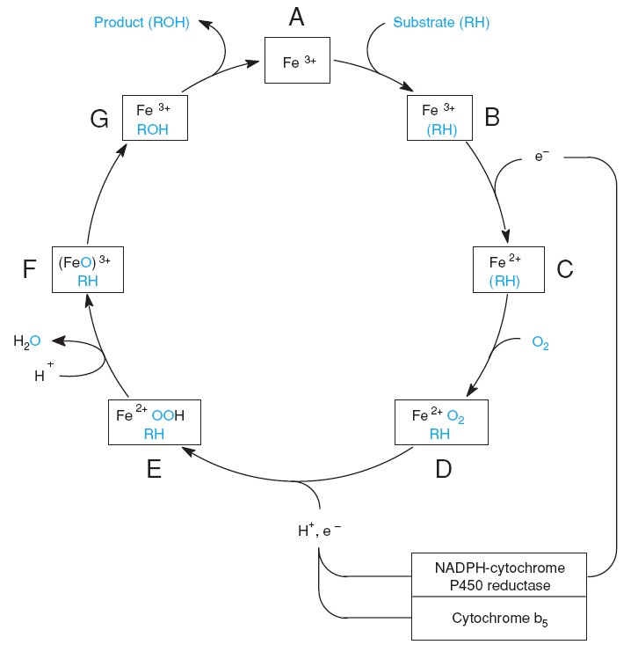
CYP Mechanism
The cycle starts with substrate binding to heme
Fe³⁺ is reduced to Fe²⁺ in a 1-electron reaction
O₂ then binds to the enzyme
O₂ is then "activated" in a 1-electron reduction
A single O atom is then dissociated with an oxidation of Fe²⁺, and protonation of complex involves H₂O leaving
The remaining O atom is highly energetic and reacts with the substrate, which then leaves

Slide 57
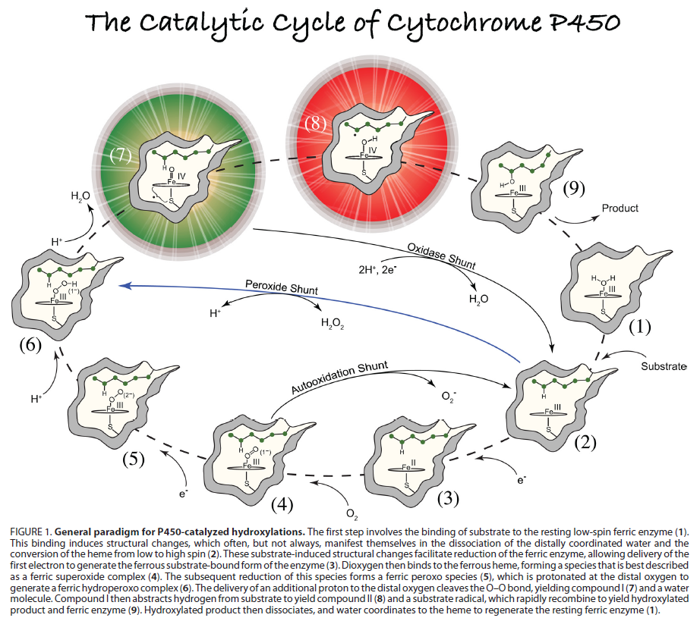
Recent Understanding

Slide 58
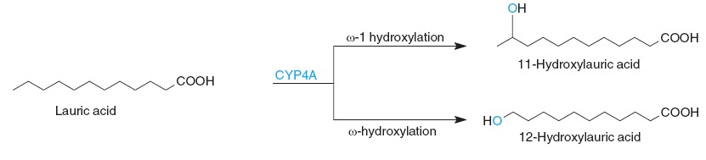
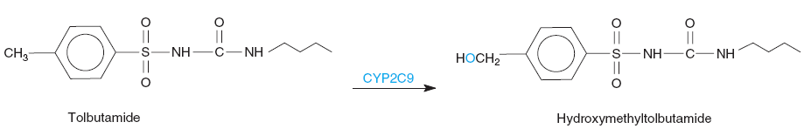
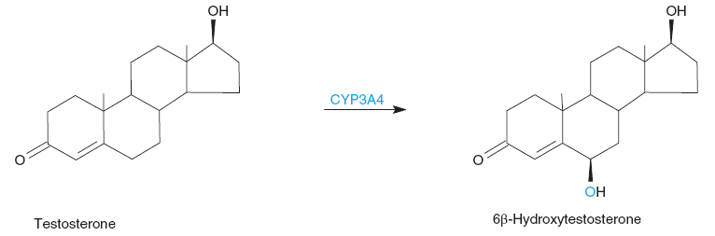
Specific CYP Reactions
Mono-oxygenation (hydroxylation) of the tail-end of long-chain alkyl groups is important
Tolbutamide is used to treat type 2 diabetes
Used in the catabolism of natural metabolites, steroids
There are far too many chemical reaction types catalyzed by CYP enzymes to show in this course: oxygenation of N and S atoms; dealkylation of O, N, S, Si; deamination, desulfuration by oxidation; epoxidation

Slide 59
Conjugation (Phase II Reactions)
Conjugation is the biochemical reaction of adding a functional group (often a large molecule) to the molecule that is either the toxicant or its product(s) that underwent Phase I reactions
Molecules that are conjugated to toxicants will give the xenobiotic more polar (multiple –OH groups) or electrically charged (particularly anionic or negatively charged) groups
Purposes
Primarily to increase the water solubility for excretion
Ipso facto, reduce the lipophilic character that allows xenobiotics to traverse membranes into other compartments
Put a "tag" on a xenobiotic that marks it for excretion
Potentially reduce its toxic nature (even further)

Slide 60
Conjugation Reactions
Glucuronidation
attaches a large anionic sugar acid (glucuronic acid) using UDPGlcA, to O atoms on ROH/RCOOH, N atoms on amines, S atoms on thiols
Sulfation
attaches anionic –SO₃– to –OH using PAPS
Acetylation
modifies usually amine groups with an acetyl (CH₃COO–) group using acetyl-coenzyme A

Slide 61
Conjugation Reactions
Methylation
Methyl group transferred to O, N, and S atoms using S-adenosylmethionine (SAM)
Glutathione conjugation
the thiol (–SH) group of glutathione can be involved in aromatic substitutions, C=C additions, oxidations,
Note that glutathione is a 3-amino acid compound: γ-Glu-Cys-Gly
Amino acid conjugation
the amine (–NH₂) group of the amino acid transfers to an acyl carbon atom in a nucleophilic acyl substitution
the carboxyl group can transfer from a tRNA synthetase to O atom of hydroxylamines
amino acids such as glycine, glutamine, serine, taurine

Slide 62
Activated Conjugation Reactant
It is important to note that all groups transferred to the target toxicant in the conjugation reaction are activated
Activated means "brought to a higher energy state"
UDPGlcA is formed from UTP
acetyl-Coenzyme A is produced by two high energy phosphate ester bonds from ATP
S-adenosylmethionine is formed from ATP
PAPS formation is driven by use of two ATP

Slide 63
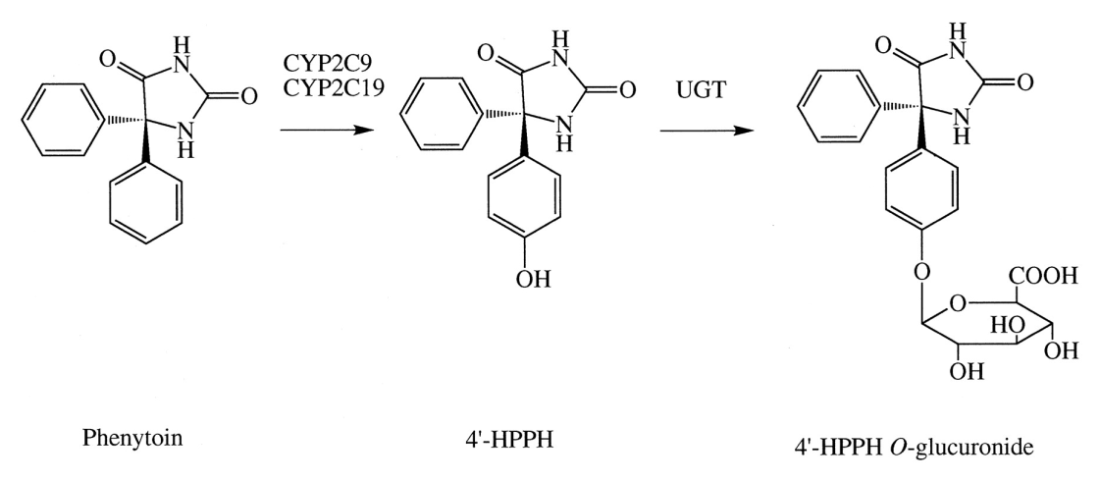
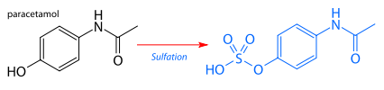
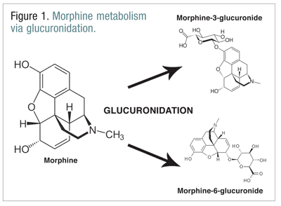
Specific Conjugation Reactions
The anticonvulsant phenytoin is hydroxylated on the ring by the P450 enzyme and then conjugated with glucuronic acid
Sulfation of acetominophen
The opiate morphine glucuronidated in several locations

Slide 64
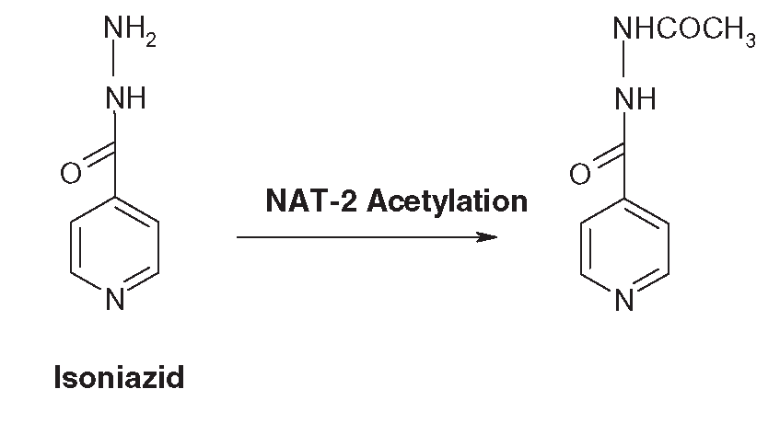
Specific Conjugation Reactions
Acetylation of the anti-tuberculosis drug isoniazid
Sulfation of acetominophen
The opiate morphine glucuronidated in several locations

Slide 65
In the very useful table on biotransformation reactions on the next slide, 3 columns are shown
The 1st column shows the chemical functional group on the toxicant to be modified or transformed
The 2nd column shows the enzyme (class) that performs the reaction/modification/transformation
The 3rd column shows the type of reaction, indicating the product to be obtained
Note that the table has two columns of the 3-column

Slide 66
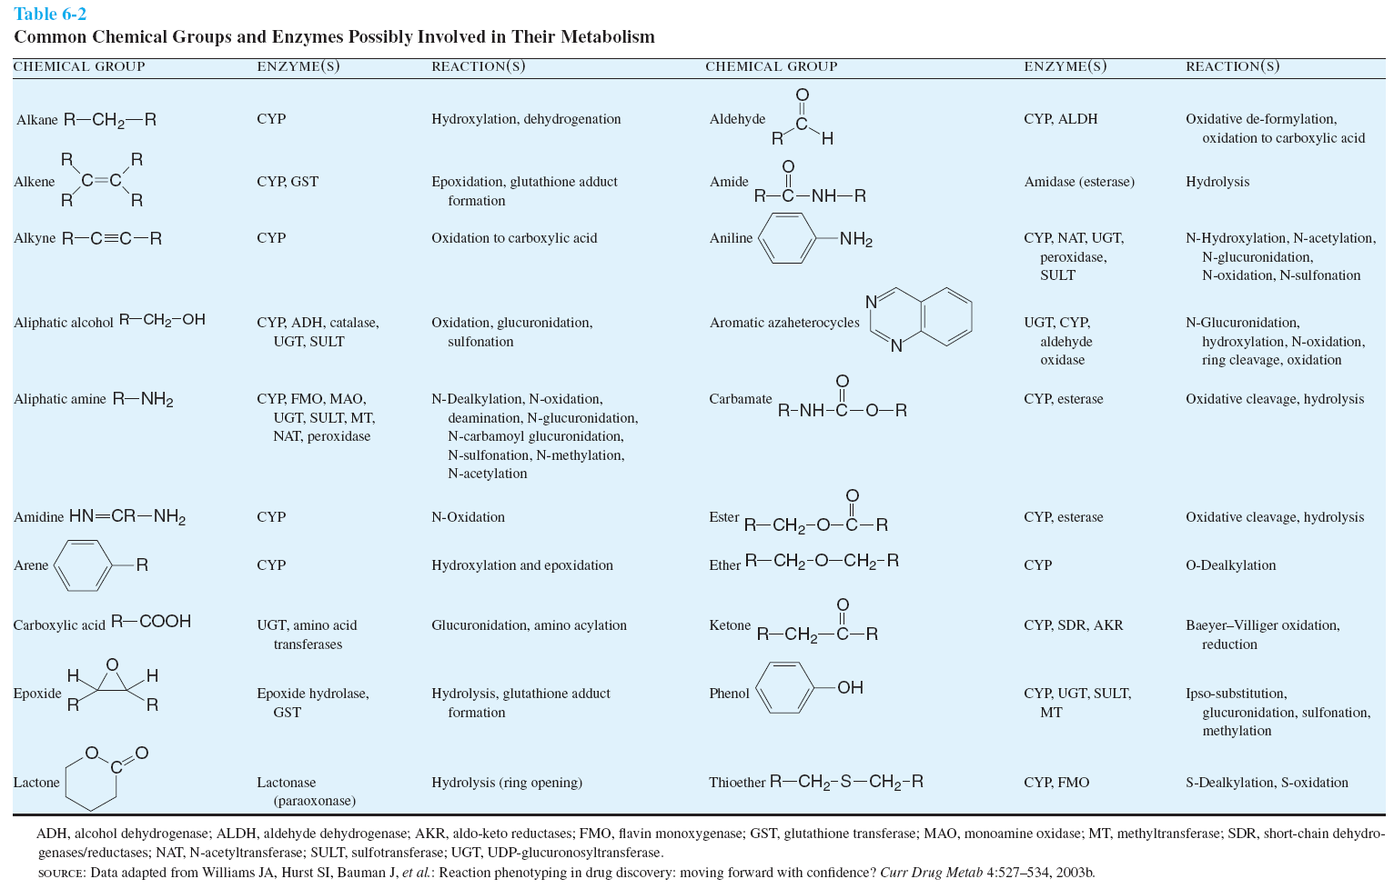

Slide 67
Phases?
There is criticism of the use of the Phase I and Phase II to describe biotransformations, as it implies a temporal sequence of reactions
There are cases where conjugation ("Phase II") reactions precede oxidation ("Phase I") for example
Aside from the debates, do not think of Phase I or Phase II as the temporal relationships, but rather as categorization of biotransformation processes

Slide 68
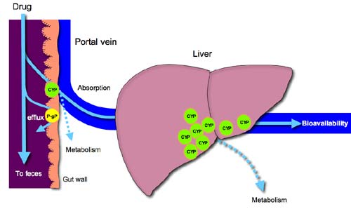
This visually summarizes previous slides, showing how a drug or toxicant can get absorbed or not, and how it will be potentially metabolized in the liver before getting a chance to be distributed in the body
CYP = cytochrome P₄₅₀ enzymes
P-gp =
P-glycoprotein
representing itself and other ATP-binding cassette (ABC) efflux transporting membrane proteins involved in multi-drug resistance
http://www.doctorfungus.org/thedrugs/images/antifung_1.jpg

Slide 69
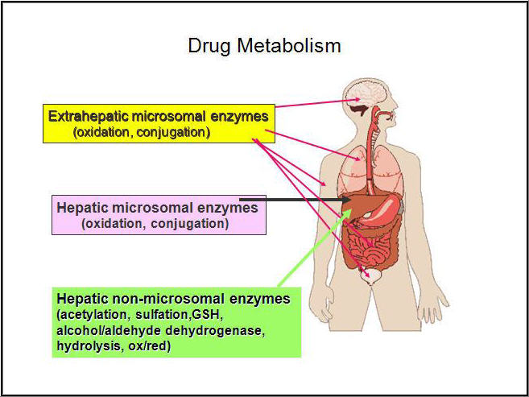
This is to summarize what toxicant/drug metabolism (biotransformation) is about, and generally where it happens in the body
http://intranet.tdmu.edu.ua/data/kafedra/internal/magistr/classes_stud/English/First%20year/Clinical%20Pharmacology/01_Clinical%20pharmacokynetic_pharmacodynamic.files/image017.jpg

Slide 70
Excretion
The process of eliminating the drug or its (de-toxified) products
Routes of elimination
Urine (kidney)
Feces (GI tract and biliary elimination)
Exhalation (lungs)
Sweat (skin)
Saliva (oral)
Breast Milk
Major routes are through urine and feces, so we concentrate on these

Slide 71
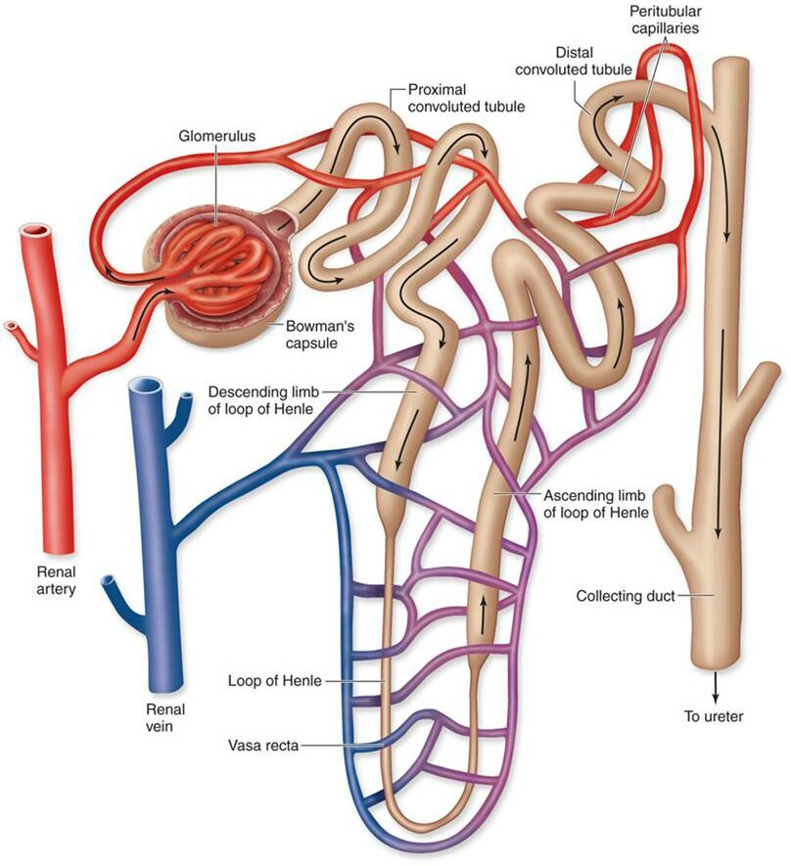
Kidney
More xenobiotics excreted by kidney than any other route
The nephron is functional unit of excretion
Glomerulus
Proximal convoluted tubules
Distal convoluted tubules
Collecting ducts
Water-soluble compounds of low MW (< 350 Da)

Slide 72
Urinary Excretion
Glomerular filtration
water + small molecules pass through net from plasma into proximal convoluted tubules (PCT)
compounds of < 60 kDa pass through large pores
albumin-bound xenobiotics retained in blood
polar and ionized toxicants filtered here may be excreted
Tubular Reabsorption
diffuse from tubule back into peritubular capillaries
Active secretion into tubules
Most drugs excreted by this process

Slide 73
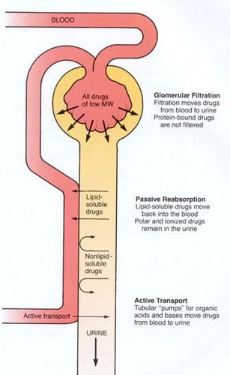
Tubular Reabsorption/Secretion
Lipophilic drugs will be re-absorbed in the proximal convoluted tubule (PCT), while ionized toxicants will pass out to the urine
Organic anions and cations can be actively secreted into the PCT from the adjoining blood vessels
https://o.quizlet.com/i/ZfKbIDUW0AbVVEH4_97uOg.jpg

Slide 74
Characteristics of Bile
Bile is a yellow-colored mix of bile acids, glutathione, phospholipids, cholesterol, bilirubin (heme metabolite), organic anions, proteins, metals, inorganic ions, xenobiotics

Slide 75
Formation of Bile in Liver
More xenobiotics excreted by kidney than any other route
The liver plays its part
Hepatocytes form channels (canaliculi) between adjacent cells with tight junctions to make intercellular access impermeable
Proteins on the membrane forming canaliculi contain efflux transporters for organic anions and for lipophilic molecules. These become part of bile.
Bile is a yellow-colored mix of bile acids, glutathione, phospholipids, cholesterol, bilirubin (heme metabolite), organic anions, proteins, metals, inorganic ions, xenobiotics

Slide 76
Biliary-Fecal Excretion
Bile is transported from liver and delivered by a duct into the duodenum of the small intestine
it may be temporarily stored in the gall bladder
Components of bile relevant to toxicology—conjugated and/or biotransormed toxicants/xenobiotics may then be excreted in feces
Intestinal bacteria could however alter the chemistry of the byproducts, making it possible a toxicant or its metabolite is re-absorbed, thus re-exerting an effect

Slide 77
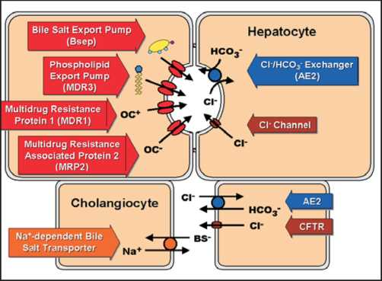
Bile Formation Review

Slide 78
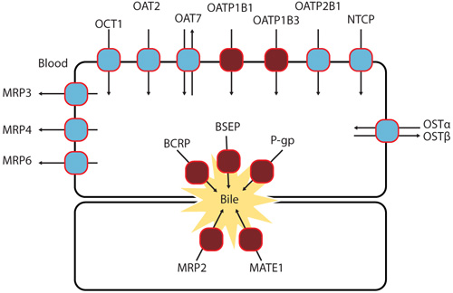
Bile Formation Review

Slide 79
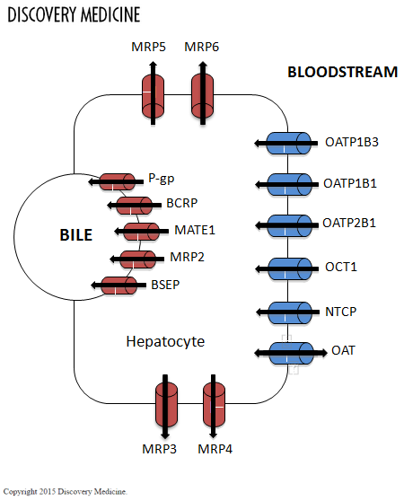
Bile Formation Review
Select transporters expressed on the canalicular and sinusoidal membrane of hepatocytesl. Influx transporters (blue) transport drugs from the blood into hepatocytes where they are metabolized. Efflux transporters (red) then efflux drugs and their metabolites into bile or back into the blood. MATE1, multidrug and toxin extrusion 1 protein; MRP, multidrug resistance protein; NTCP, sodium/ltaurocholate cotransporting polypeptide; OCT, organic cation transportier

Slide 80
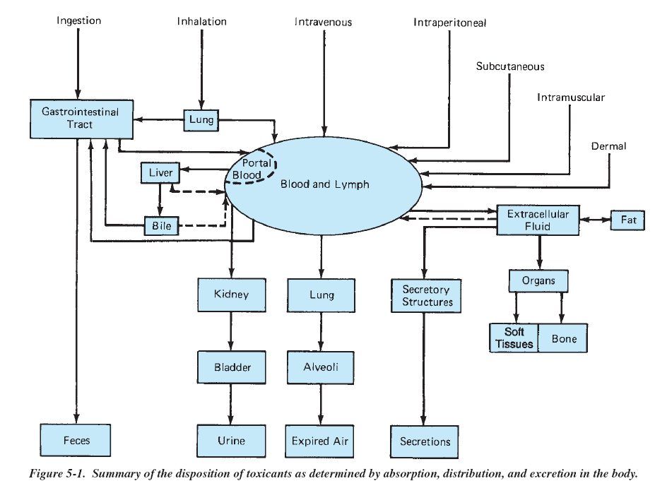

Slide 81
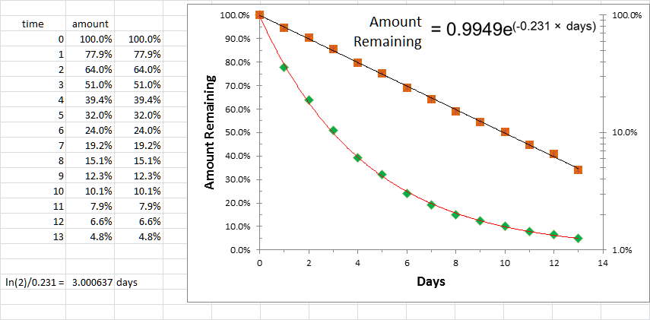
Half-Life
The time period between an initial amount of something (a substance) to the point where half of the initial amount is present

Slide 82

Drug/Toxicant Half-Life
The half-life of a drug depends on its volume of distribution and clearance
For patients taking therapeutic drugs, the half-life is used to determine the dosing interval in order to maintain a steady-state level (concentration) to maintain the therapy/effect
For drugs with a narrow therapeutic index (TI), the time required to reach a steady-state level could be much longer since patient body fluids (serum) must be assayed to monitor dose with serum levels
This value can be computed as
$$t_{1/2}=\frac{\ln{2}}{k_{\text{el}}}$$
where k_{el} is the rate of elimination of the drug from the blood

Slide 83
Group Project
Find partner
Decide an area of interest
Develop clear, concise research question in the area of interest
Clarify the specific aims in answering the question
Do literature search to establish knowledgebase (heavy note taking)
Before start of Week 3, submit following
research question (item 3)
proper bibliography along with question before start of Week 3

